Slide 1
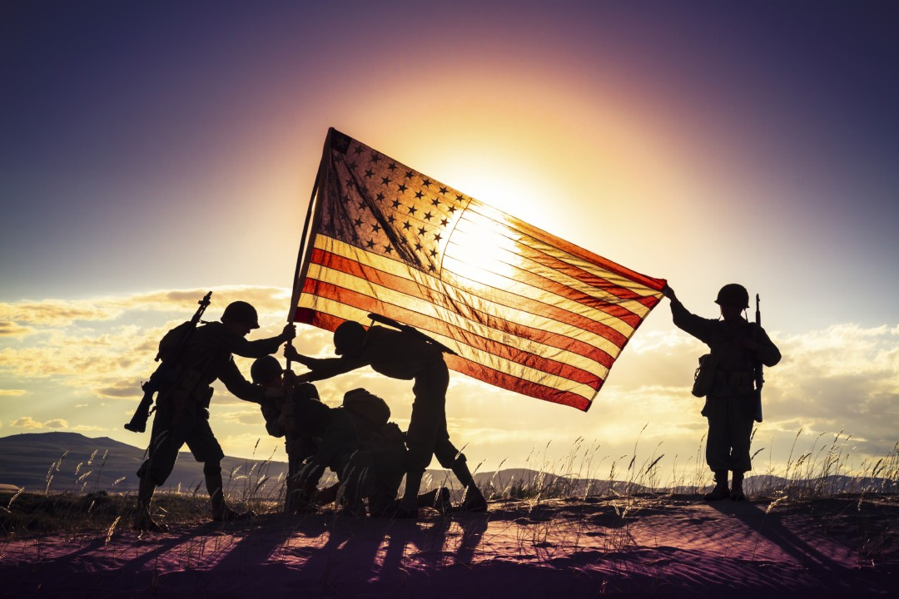


REMEMBER, CELEBRATE, and ACT
BGAD is holding its next
Disabled Veteran / Veteran
Lunch & Learn Workshop
Wednesday, 4 September 2024, 1130-1230
@ The IGLOO Club Turner Room
Topics discussed: VA Benefits
Guest from: EKU Veteran Affairs, Madison County Vet Center; KY Career CTR; KY VALOR; Lexington Vet Center; KDVA and others
The Depot Commander has authorized an additional
30 minutes to the lunch hour, for those in attendance.
Be sure to get authorization from your supervisor.
Although the information is geared for Disabled Veterans.
ALL EMPLOYEES ARE WELCOME
POC: Leo Carver at (859) 779-6044 or email: dwarn.l.carver2.civ@army.mil

